Slide 1
LED CHASER CIRCUIT
CHOLETI NITHIN , B200283EE ,A BATCH
ANNAPAREDDY RUSHENDRA REDDY,B200302EE,A BATCH

Slide 2

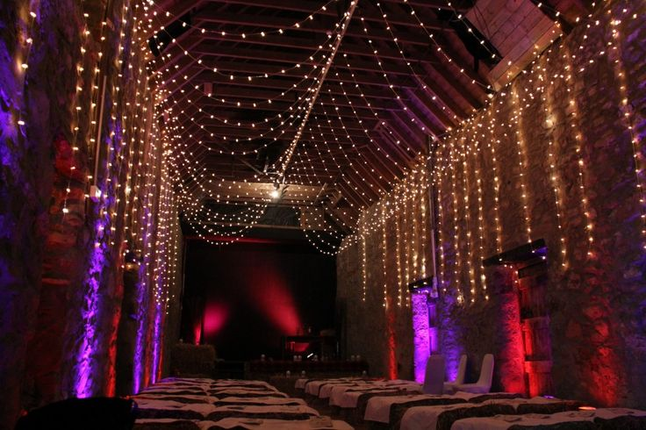
What is LED chaser circuit ?
Light chasers are decorative lights or LEDs arranged in different moving patterns which create a chasing light or running light kind of effect. These look very interesting and are surely eye catching and that’s why these types of lighting arrangement have gained immense popularity in today’s world

Slide 3
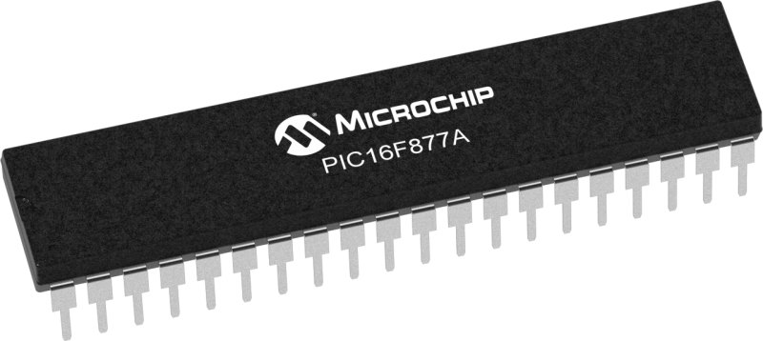
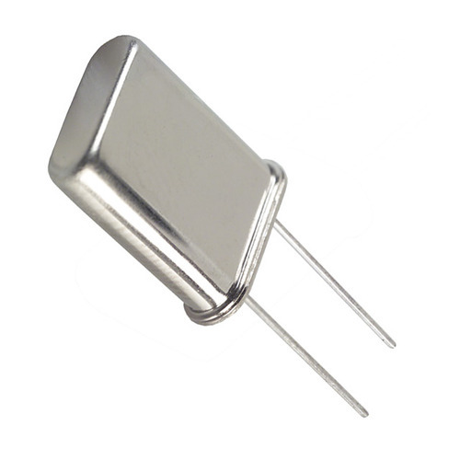
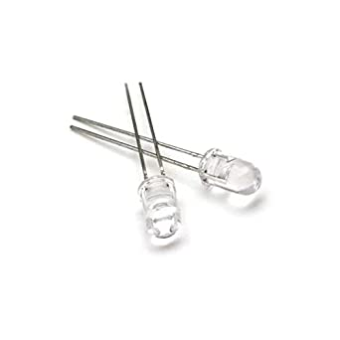
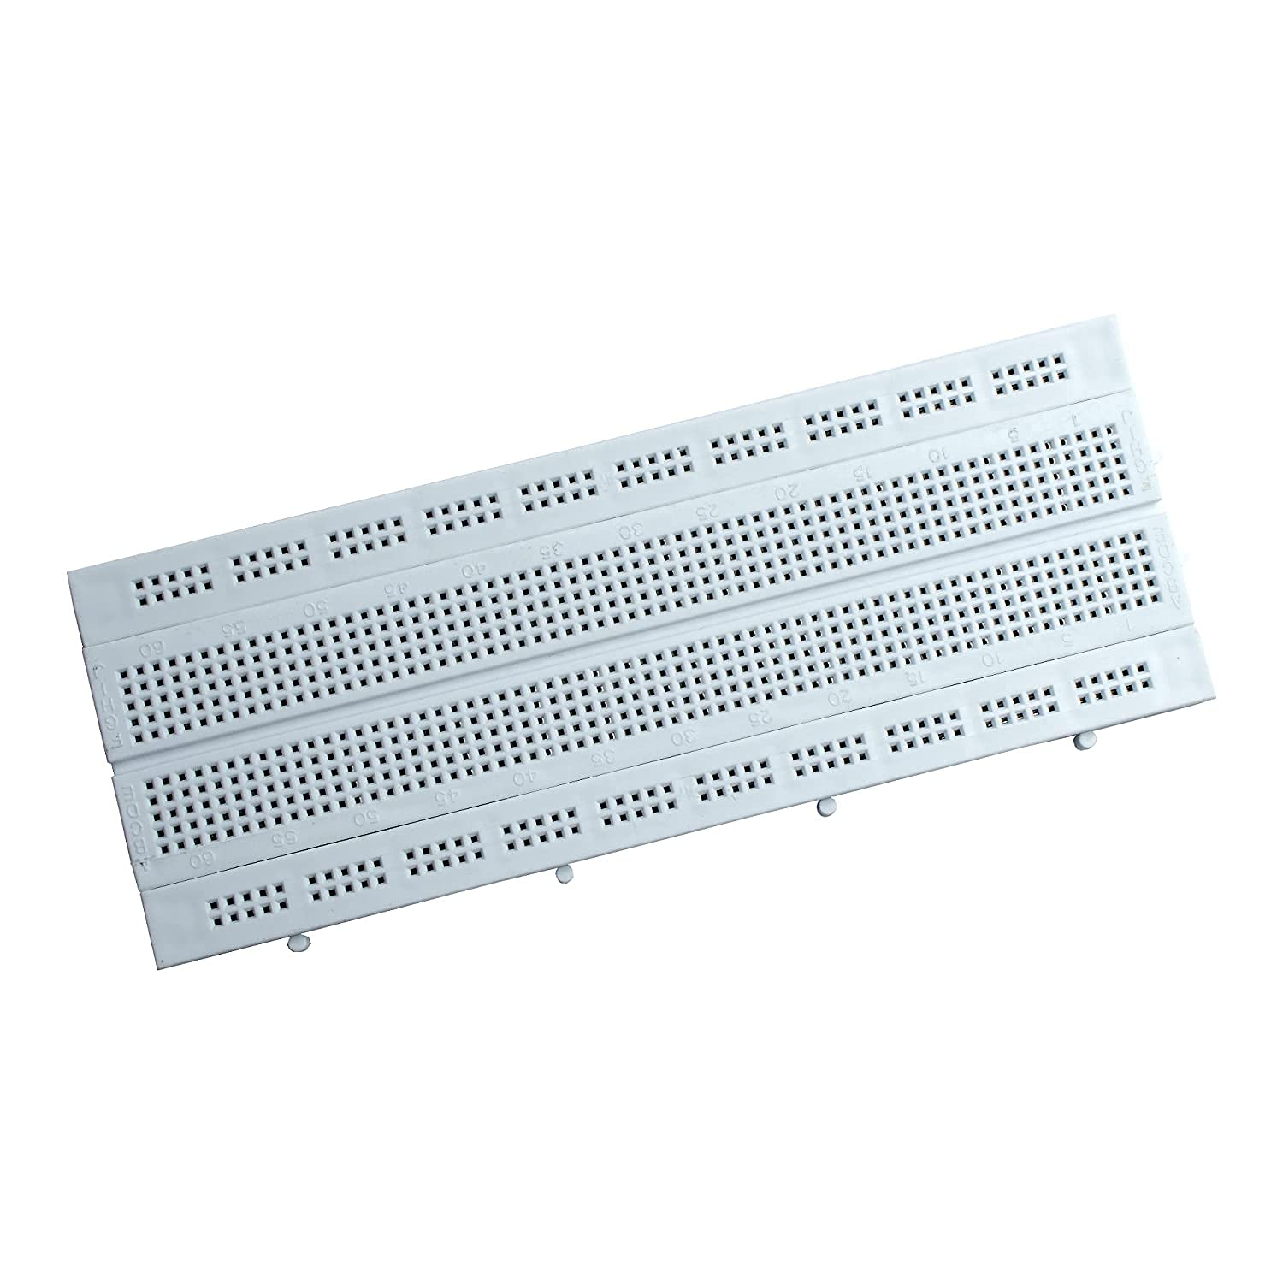
Chaser using PIC Components Required
Component
specification
picture
Microcontroller
Crystal oscillator
LEDs
Capacitors (2)
Resistors(8)
Breadboard
PIC16F877A
8MHz
General purpose
22pF
220 0hm

Slide 4

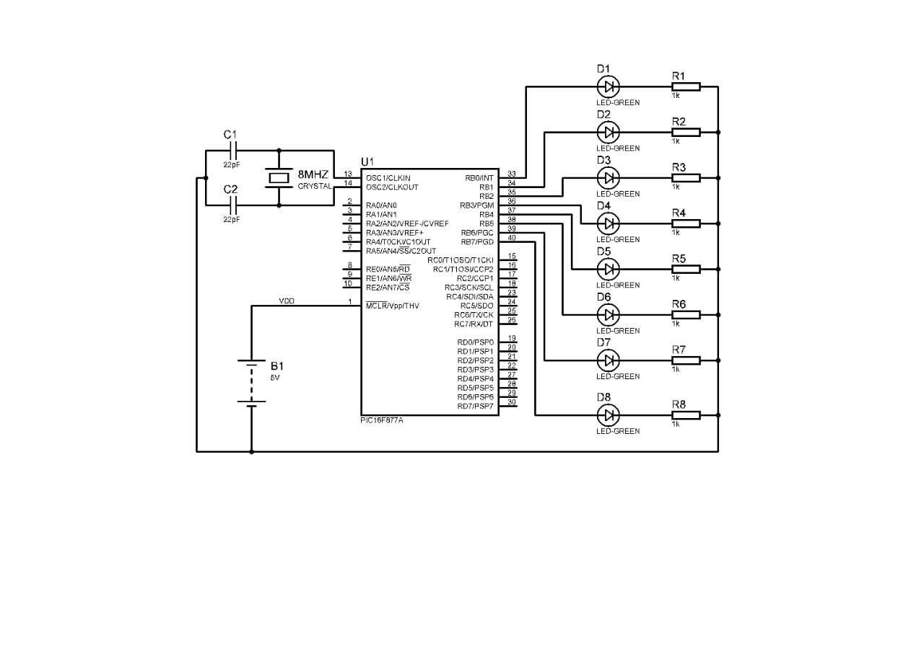
Schematic and code
schematic
Code

Slide 5
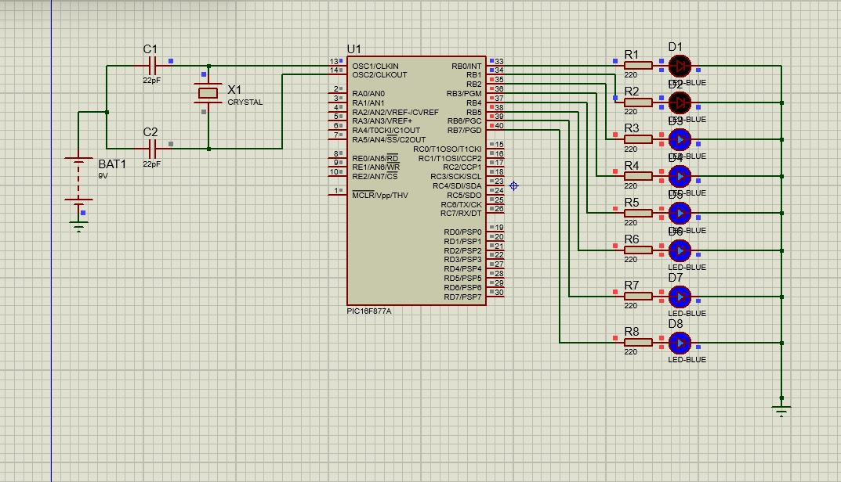
SIMULATED CIRCUIT

Slide 6
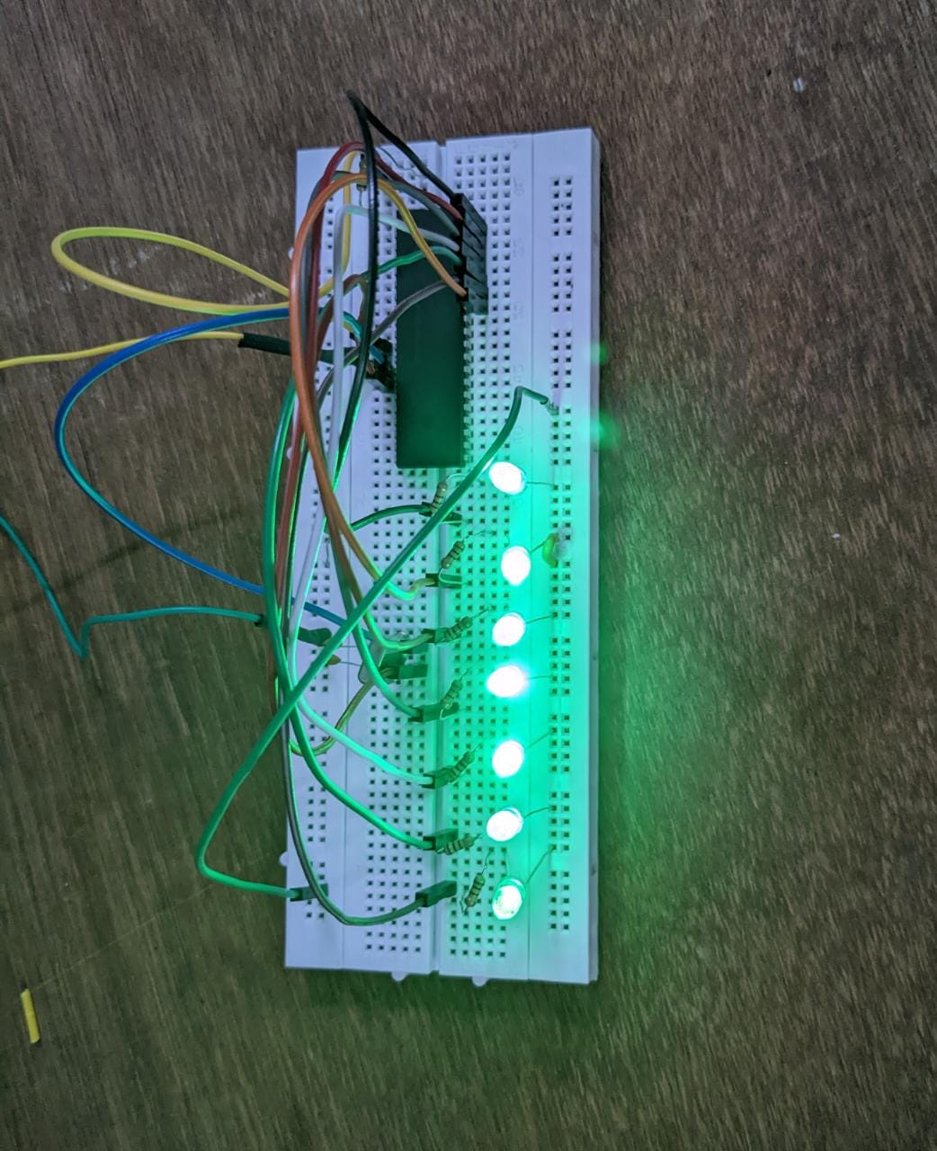
ASSEMBLED HARDWARE

